Slide 1
Personalized Public Displays
Evaluation
Juan Camilo Garcia Henri Koski Yifei Zuo Haejong Dong

Slide 2
Table of contents
Purpose of the Project
Evaluation process
System Evaluation
User Evaluation
Discussion
Future Work
Contributions

Slide 3
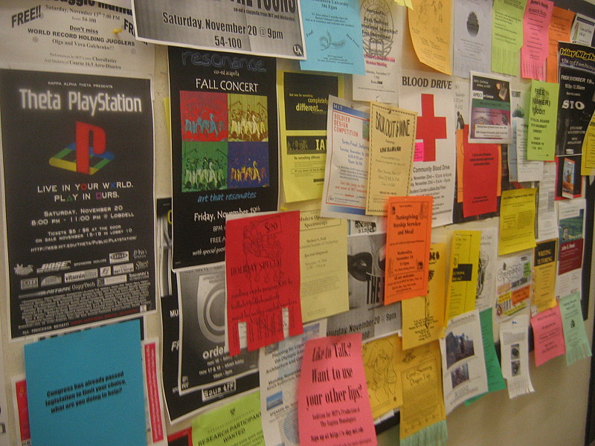
Purpose of the Project
Provide a better alternative to bulletin boards
Make bulletin boards smart.
Personalise Public displays.
Notes:
Hard to find useful information
Hard to find changes
DIfficult to update changes

Slide 4
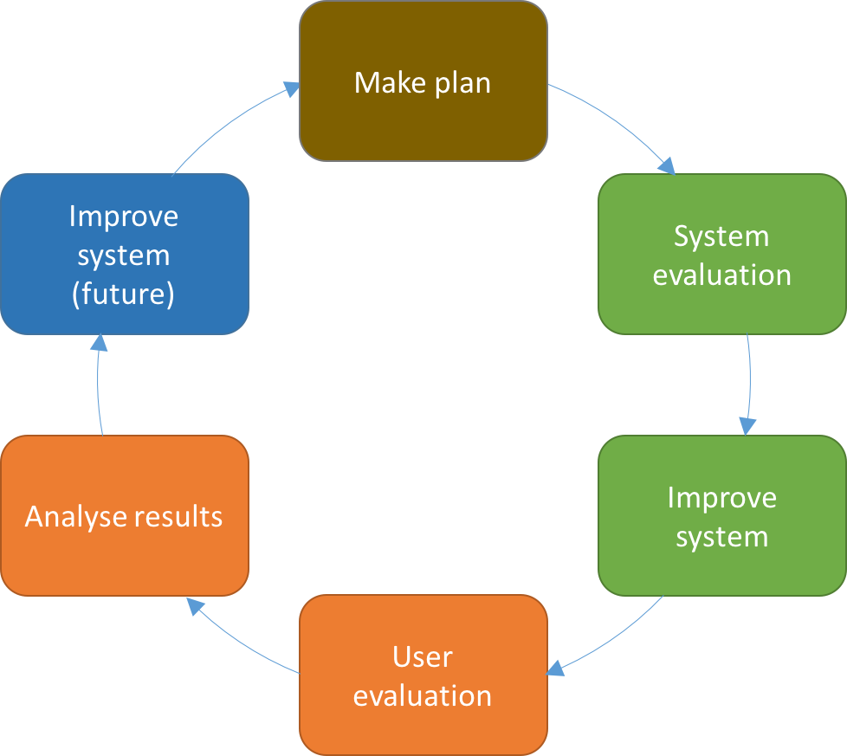
Evaluation process
Notes:
Feedback to local government
Queue estimations
Micro tasks (as workstations)
More into our topic:
Personalise content: Google search, Youtube videos, songs, images, etc
Focused on security, how to communicate and find public displays

Slide 5
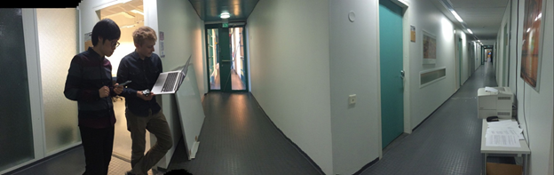
System Evaluation - User Detection
Speed of personalisation
Expected: 10-20 seconds
Measured: 28.6 seconds (25.6,31.3)
Maximum distance of recognition
Expected: < 46 meters
Measured: > 90 meters
Notes:
Speed: 20 samples
90 meters - 5 km/h - 2 minutes

Slide 6
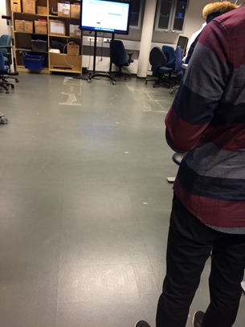
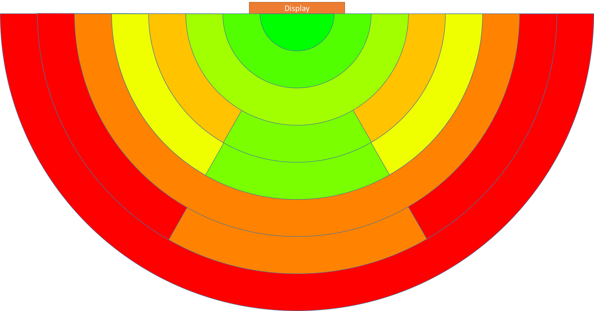
System Evaluation - User Proximity
Measured every meter (front and side)
Signal Strength heatmap
Expected: Many areas with false positives
Measured: Areas with false positives
Notes:
Speed: 20 samples
90 meters - 5 km/h - 2 minutes

Slide 7
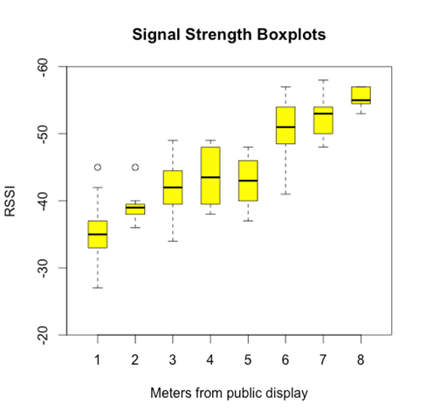
System Evaluation - User Proximity
Notes:
Speed: 20 samples
90 meters - 5 km/h - 2 minutes

Slide 8
System Evaluation
User Detection:
Worked as expected.
Personalisation will only happen when RSSI is stronger than -50.
Found a long session detection error.
Solution: When the phone is detected, WiFi scans are forced until the device is no longer visible.
User Proximity Detection:
Worked as expected (with errors).
Solutions:
Show a list of possible devices.
NFC reader to choose phone.

Slide 9
User Evaluation
One participant at a time
Few instructions
Process:
Public display
Few instructions, let them interact freely
Find information
Mobile application
Interact freely
Both
Gave some tasks
Q&A
Notes:
Speed: 20 samples
90 meters - 5 km/h - 2 minutes

Slide 10
User Evaluation
Participants
 | Age group | Gender | Profession/occupational Background | Past usage in public display | Activeness in joining public events
Subject A | 21~25 | Male | Student / Computer Science | Checking traffic information | Almost none (2~3 times per year)
Subject B | 21~25 | Male | Student / Computer Science | Entertainment application (selfie app) | Almost none (once in many months)
Subject C | 21~25 | Male | Student / Computer Science | Checking nearby services | Almost none (2~3 times per year)
Notes:
Speed: 20 samples
90 meters - 5 km/h - 2 minutes

Slide 11
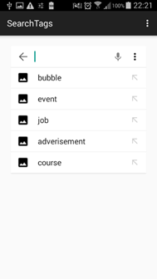
User Evaluation - Feedback
Tag system was complex.
Notes:
Speed: 20 samples
90 meters - 5 km/h - 2 minutes

Slide 12
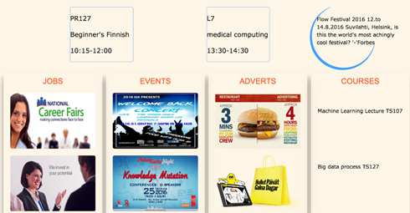
User Evaluation - Feedback
Titles of categories seemed too broad.
Notes:
Speed: 20 samples
90 meters - 5 km/h - 2 minutes

Slide 13
User Evaluation - Feedback
Too long to personalise.
System seemed like a search engine.
“I don’t know what information I may need, if I knew I would actively search for it”.
Automated personalisation
Other results:
Hardware issue using touch system.
Sending content to the phone didn’t work properly because of the false positive areas.
Notes:
Speed: 20 samples
90 meters - 5 km/h - 2 minutes

Slide 14
Discussion
Future Work
Idea is viable.
UI tweaking necessary for users to understand the system.
Lack of experience with public displays makes it hard to understand.
Automated personalisation would be the final goal.
Passive system seen as an active system.
Improve dynamics of sending information to the phone.
Redesign the UI to communicate what the system does better.

Slide 15
Contributions
Name | Contribution | Hours
Haejong Dong | System Evaluation, User Evaluation, Report Writing | 29
Juan Camilo García | System Evaluation, User Evaluation, Report Writing | 20
Henri Koski | System Evaluation, User Evaluation, Scalability and Fault Tolerance | 16
Yifei Zuo | System Evaluation, User Evaluation, Report Writing | 18
Simo Hosio | Feedback | N/A

Slide 16
Thank you for your time

